Slide 1
Bonded Medical Program
New Arrangement
Presented by Abha Bedi
Australian Government
Department of Health
Rural Health West
27 November 2019, Perth
www.health.gov.au

Slide 2

Acknowledgement of Country
I would like to acknowledge the Traditional Owners and Custodians of the lands on which we are meeting on today and pay my respects to their Elders past, present and emerging
I would like to extend that acknowledgement and respect to any Aboriginal and Torres Strait Islander peoples here today
2

Slide 3
The Challenge – Doctor Shortage in Rural and Remote Areas of Australia
Stronger Rural Health Strategy 2018-19 Budget Initiative
Undersupply of health professionals in rural and remote areas of Australia
Government ensuring primary health care is accessible and available to all Australians no matter where they live
$20.2 million investment to reform the Bonded Medical Program
Through the Bonded Medical Program, doctors who have received a Commonwealth Supported Place in a medical course at an Australian university undertake their Return of Service in rural or remote areas
3

Slide 4
Why Reforms?
Currently the Return of Service Obligation (RoSO) work period of the Bonded Medical Program ranges from 12 months to 6 years
Bonded doctors (over 15,000) require more support to meet their RoSO requirements
Increasing administrative burden for the Department of Health in managing large numbers of bonded doctors on different programs and contracts
Difficult for bonded students and doctors to understand and manage their RoSO
4

Slide 5
Promising Practice
Current State
28.5% of Commonwealth Supported Places for students in Medicine are bonded
Bonded students have a RoSO to work in rural and remote areas after completing their medical degree ranging from 12 months to 6 years
15,000 (approx.) currently bonded doctors with 10,000 (approx.) completing medical degree or vocational training
700 bonded doctors have commenced their RoSO
150 doctors have completed their RoSO
Future State
Numbers are expected to increase each year
Australia is heading to an oversupply of 7,000 doctors by 2030
5

Slide 6
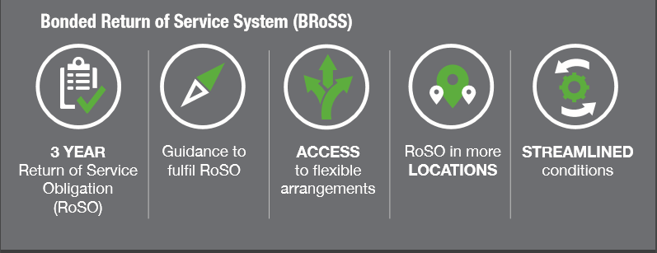
Promising Practice – The Bonded Medical Program New Arrangement
Bonded Medical Program
New Arrangement from 1 January 2020
  Will provide support and flexibility for bonded doctors to work and stay in rural and remote locations
  From 1 January 2020 the new arrangement comes into effect
  The Department of Health is building an innovative, online web portal, the Bonded Return of Service System (BRoSS), allowing participants to plan and self manage their RoSO
6

Slide 7
Enablers for Implementation
Legislation
To replace individual contracts arrangements with a legislated regulatory model
Support for Participants
Rural Workforce Agencies (RWAs) funded to provide support to participants
Bonded Return of Service System (BRoSS)
New online application, BRoSS accessed by a web portal
The user centred design is built with stakeholder input
Allows Universities, Rural Workforce Agencies, Health administrators to provide online management and support
Phased implementation from 1 January 2020
7

Slide 8
Next Steps
New arrangement for the Bonded Medical Program will come into effect from 1 January 2020
23 participating universities will access BRoSS via their AUSkey account
850 (approx.) new applicants in the 2020 intake will join 15,000 (approx.) existing participants expected to opt in to the new arrangement
RoSO fully automated in BRoSS by mid-2020
8

Slide 9
Key Messages
The reformed Bonded Medical Program will deliver a more flexible system with greater capacity to attract and retain doctors in regional, rural and remote areas
The reforms include:
  Legislation to support a statutory scheme
  A custom built online application for the Bonded Medical Program
  Improved support for bonded students and doctors
9

Slide 10
Useful Resources
Part VD of the Health Insurance Act 1973 (the Act) www.legislation.gov.au/Details/C2019A00070
Health Insurance (Bonded Medical Program) Rule 2020 (the Rule) www.legislation.gov.au
Privacy Act 1988 (Privacy Act) www.legislation.gov.au/Details/C2019C00241
Bonded Medical Program Health website
health.gov.au/new-arrangements-bonded-medical-program
Email: bross@health.gov.au
10

